Slide 1




EMPLOYEE LEARNING AND DEVELOPMENT ANALYSIS AT TATA STEEL
Presented by:
Harsh Tejasvi

Slide 2


CONTENT
01
02
03
Project Objective
Acknowledgement
Data Overview
04
05
06
KPI’s
Comparative Analysis
Insights

Slide 3


ACKNOWLEDGEMENT
I would like to express my heartfelt gratitude to TATA Steel for providing me with the opportunity to undertake this internship. This experience has been invaluable in enhancing my knowledge and skills in the field.
I am deeply thankful to my guide, Mr. Sourav Ghosh, for his unwavering support, guidance, and encouragement throughout the duration of this project. His expertise and insights were instrumental in navigating the challenges I encountered, and his willingness to share his knowledge was crucial to the project's success.
I am grateful for the opportunity to work on this project, which has significantly enhanced my analytics and data visualization skills. This practical experience has been essential in furthering my understanding and proficiency in these areas.

Slide 4




PROJECT OBJECTIVE
ANALYZE COURSERA ACTIVITY
IDENTIFY AND CALCULATE KPIS
COMPARATIVE ANALYSIS
GRAPHICAL ANALYSIS
Understand the learning patterns and course engagement of TATA Steel employees on Coursera.
Determine and measure key performance indicators, such as top courses and skill growth rates.
Conduct a comparative analysis of learning patterns and skill development across different divisions within TATA Steel.
Use charts and graphs to highlight trends, showcasing the impact of learning activities over time.

Slide 5
DATA OVERVIEW
01
Dataset consists of 13 columns and 6635 rows .The columns include employee details, division, group, department, program name, course name, duration, completion status, enrollment time, completion time, learning hours spent, course grade, and skills learned.
02
The dataset contains information on 1,409 unique employees, each belonging to specific divisions, groups, and departments. In total, the data encompasses 22 divisions, 63 groups, and 289 departments.
03
There are a total of 291 unique courses in which employees
are enrolled.

Slide 6
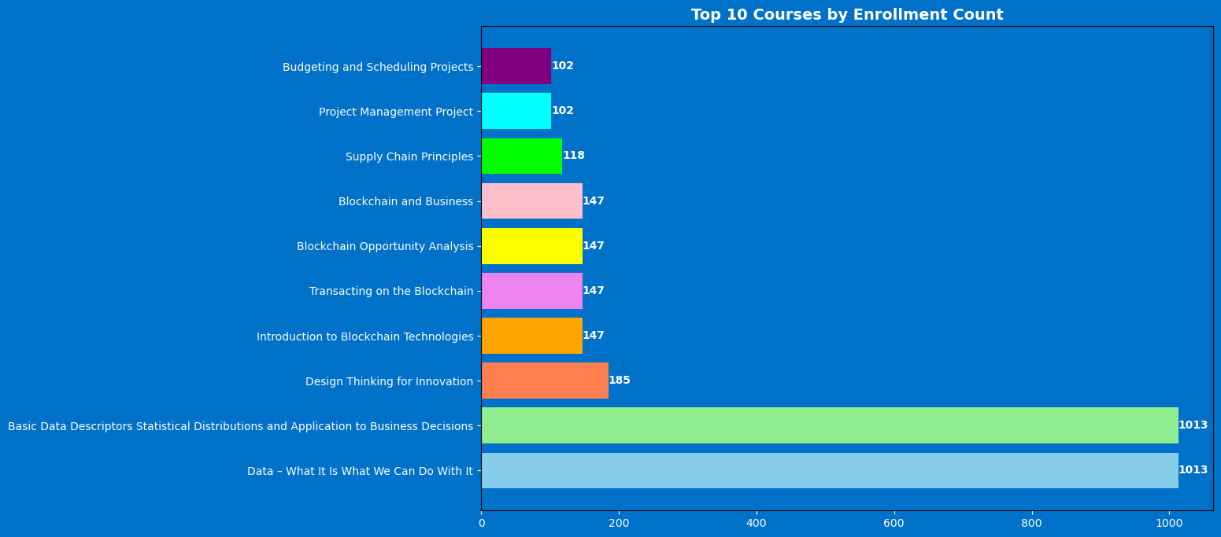
KPI’S
The graph illustrates which courses are the most popular among learners. The course with the highest enrollment count stands out significantly, indicating a strong preference or demand for that specific subject.

Slide 7
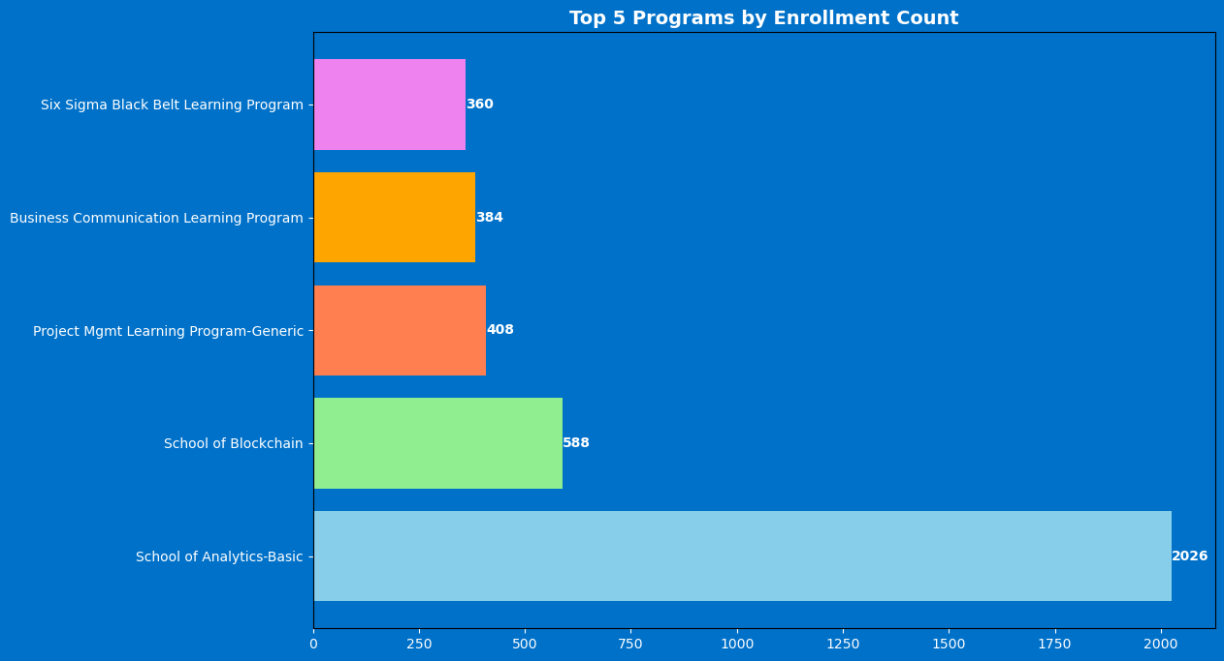
The "Data Analytics" and "Business Analytics" programs are the most popular, significantly outpacing the others in terms of enrollments. This suggests a strong interest in analytics-related fields among learners.

Slide 8
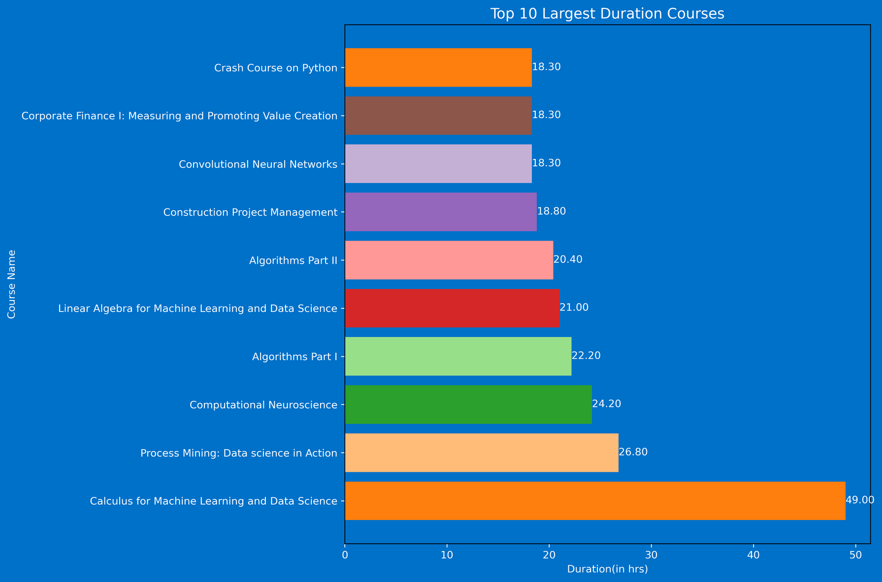
The course vs. duration graph reveals which courses require the most time investment, indicating the complexity or depth of these subjects.

Slide 9
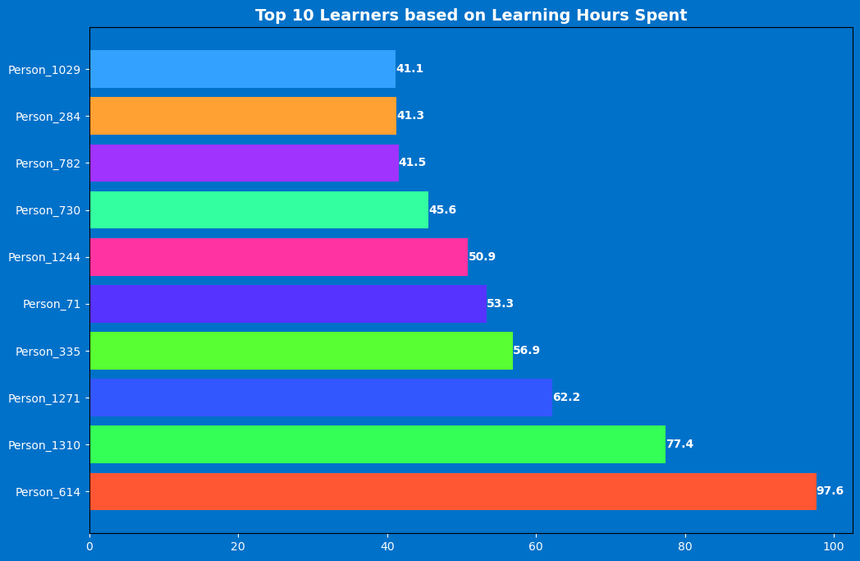
This graph shows the name of employees who have spent the most time in learning at Coursera.

Slide 10
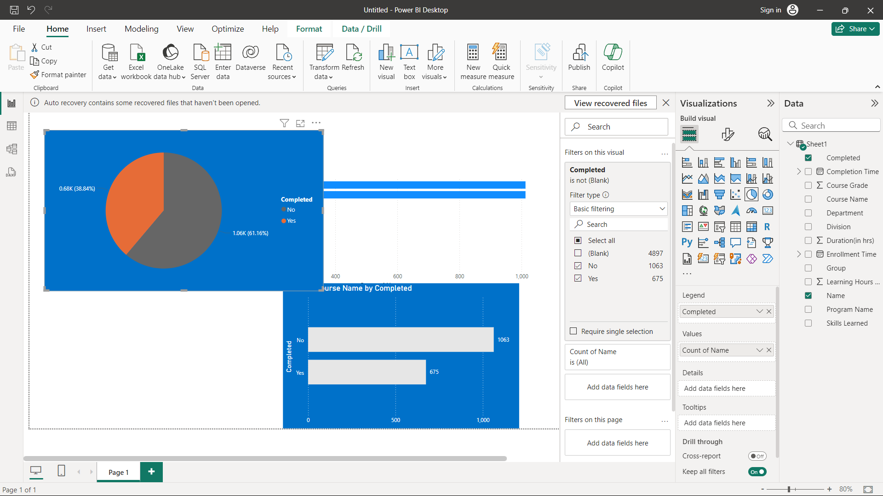
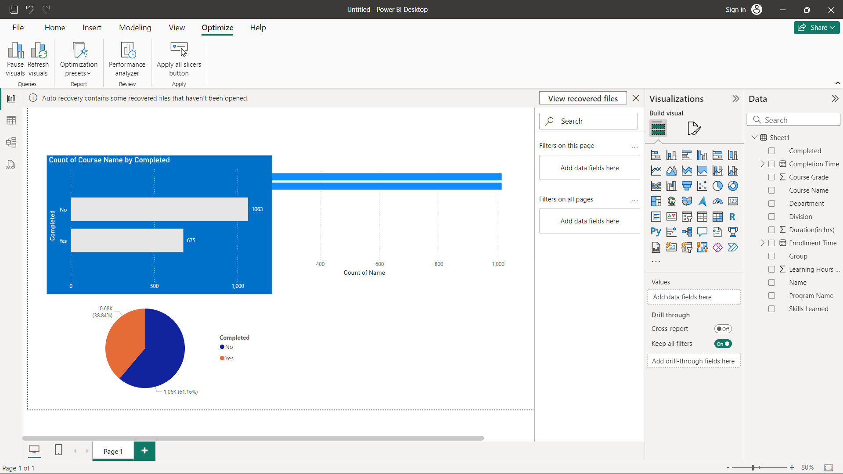
Out of 1738 enrolled courses 38.84% course have been completed by the employees.

Slide 11
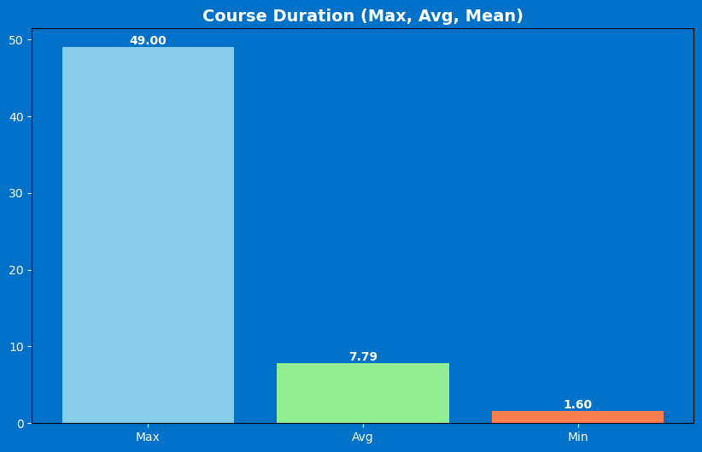
The average duration of the course is 7.79 hours and the maximum duration of a course is 49.00 hours and the minimum duration of a course is 1.60 hours.

Slide 12
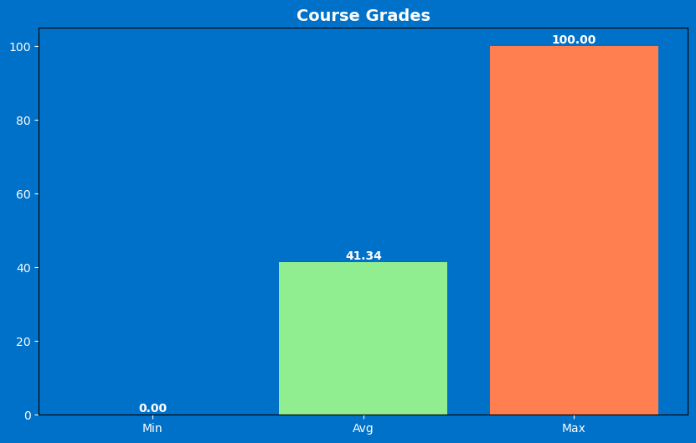
The average Course grade of the course is 41.34. Maximum Course grade of the course is 100.00 and Minimum Course grade of the course is 0.00

Slide 13
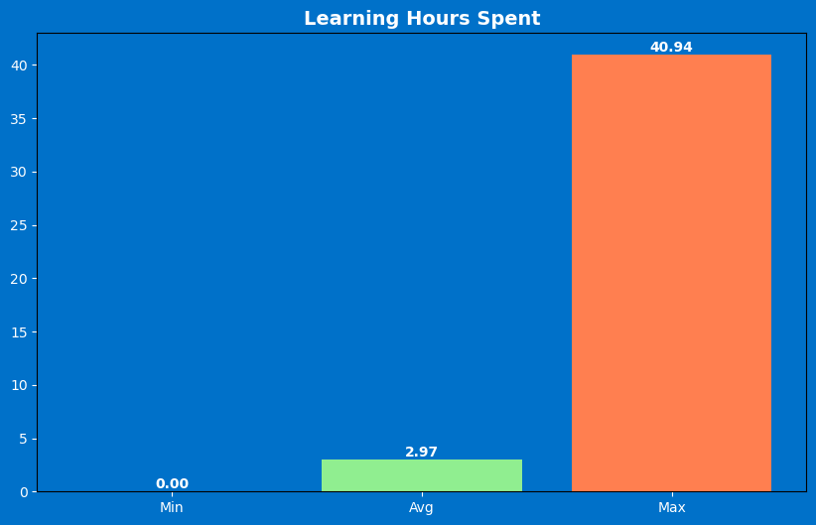
The average Learning time spent on the course is 2.97 hours . Maximum Learning time spent on a course is 40.94 hours and Minimum Learning time spent on a course is 0.00 hours.

Slide 14



COMPARATIVE
ANALYSIS

Slide 15



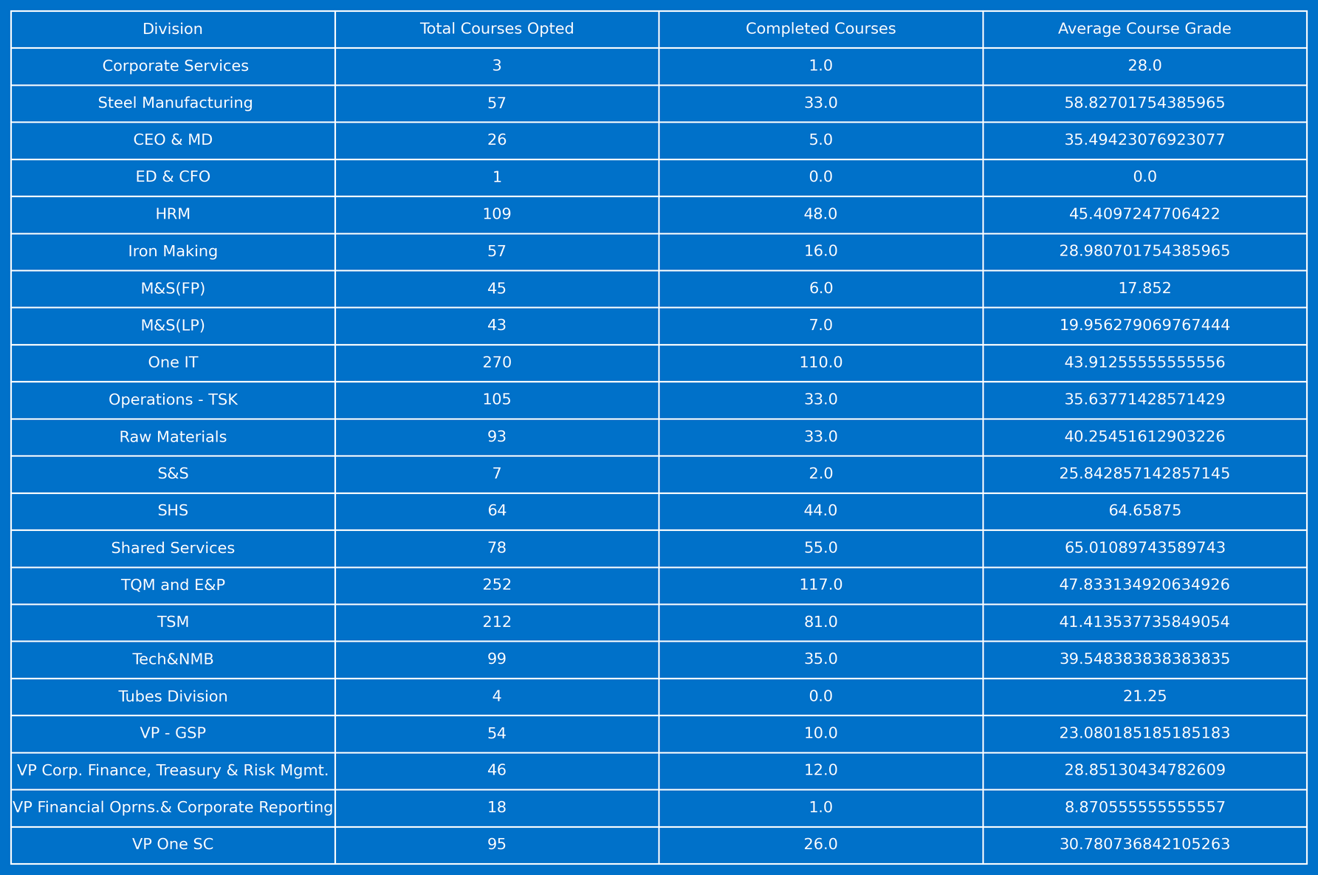
DIVISION WISE ANALYSIS
Division
No. of Course Opted
No. of Course Completed

Slide 16
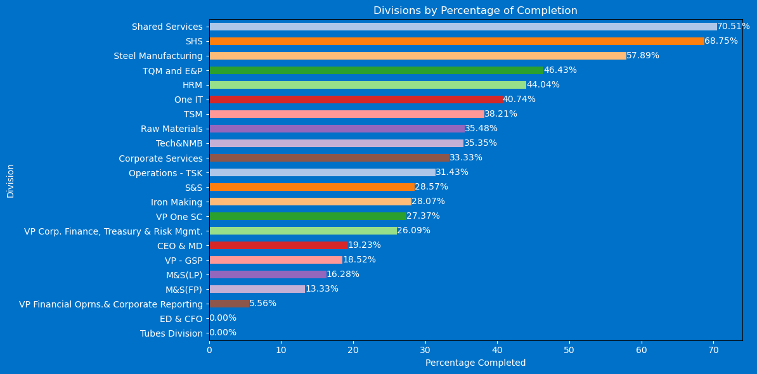
This bar graph represents the course completion percentage at various divisions in tata steel. From this, we can clearly have an idea about the participation rate in each division.

Slide 17
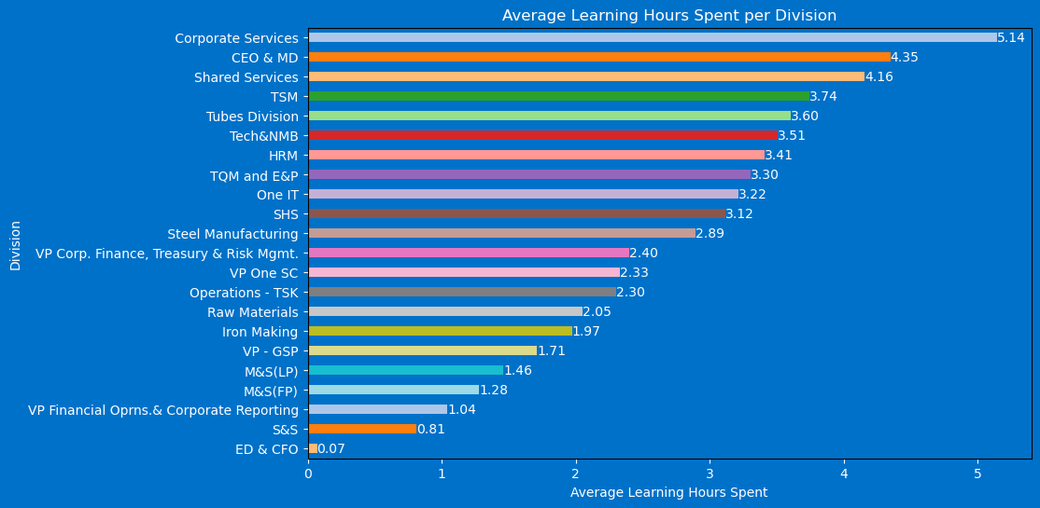
Graph represents average learning hours spent by employees in each division. It highlights the learning pattern in different division.

Slide 18
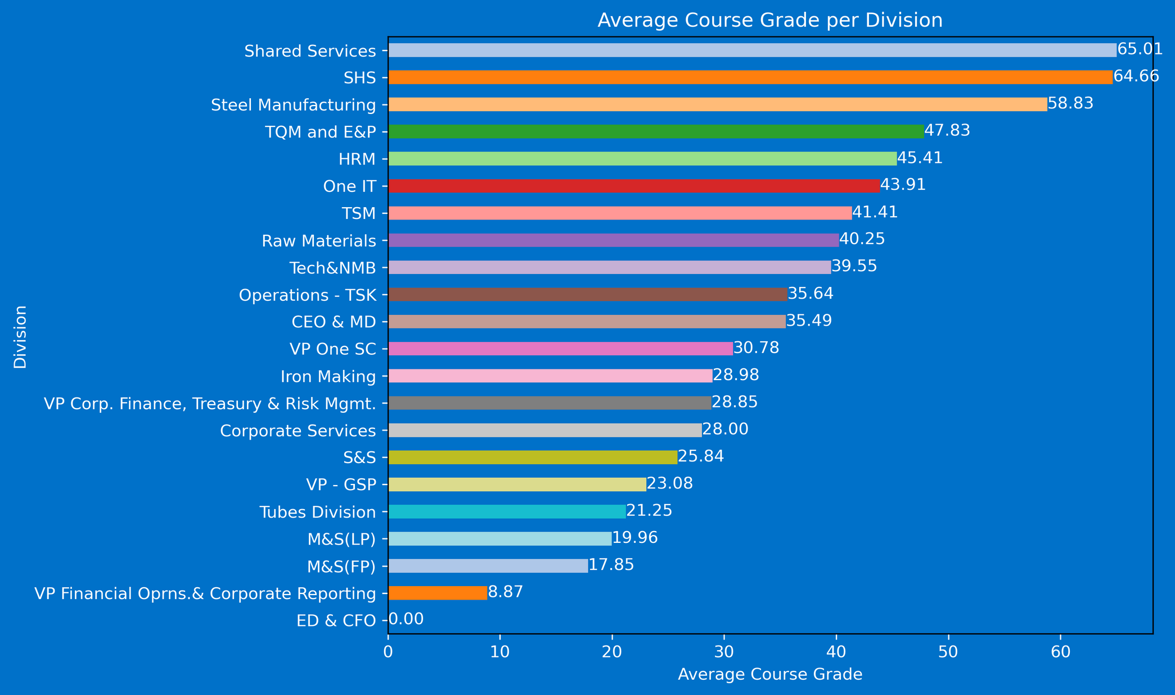
Graph represents the average course grade of each division. Higher average course grades indicate better skilled individual in that particular division.

Slide 19

INSIGHTS:
The analysis of courses with the highest number of enrollments reveals which subjects are of greatest interest to employees. This information helps identify the most popular courses among Tata Steel employees, providing insights into their learning preferences and areas of interest.
The data on the amount of time employees spend on learning helps identify those who are dedicating significant effort to enhance their skills. By recognizing these individuals, Tata Steel can identify its most skilled employees, potentially guiding decisions on promotions, mentorship roles, and further training opportunities.
The analysis also provides a detailed view of employee learning patterns, including the minimum, maximum, and average time spent on courses. Additionally, it includes data on the grades earned in these courses, offering a comprehensive understanding of employees' engagement and performance in their learning activities. This can help tailor future training programs to better suit their needs and improve overall learning outcomes.

Slide 20
Divisions with low completion rates or grades highlight areas needing additional support, revised content, or improved engagement strategies.
Courses that achieve high grades with moderate learning hours indicate efficient learning processes and effective teaching methods.
Insights into time-intensive courses can help allocate resources more effectively, ensuring challenging courses receive necessary support. Understanding group-specific preferences allows for tailored and relevant course offerings, enhancing engagement and satisfaction.

Slide 21



Thank You

